Slide 1
Global & Local Minima in Gradient Descent
By : L Vinay Rajiv Reddy

Slide 2
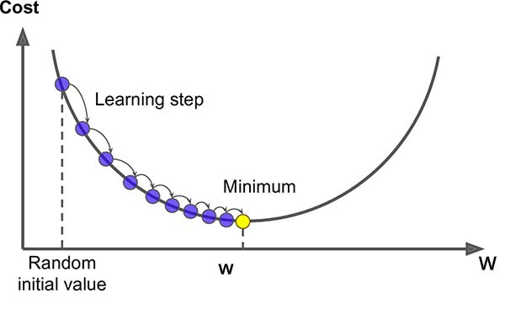
Gradient descent

Slide 3
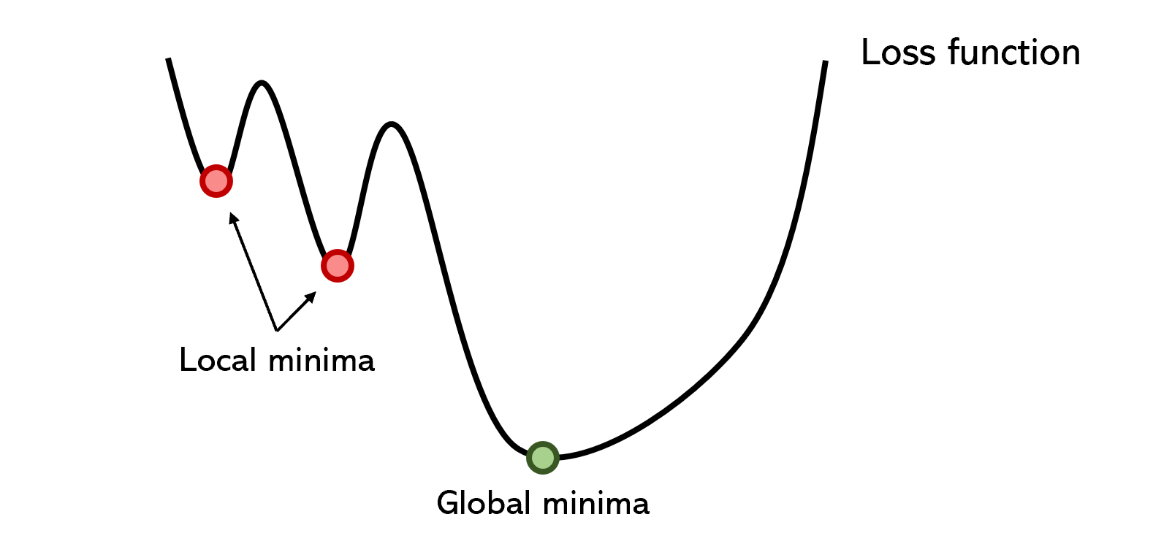
But in reality:

Slide 4


Learning Rate
Learning Rate ( ) :
m=[m-(slope * )]
Alpha should be smallest possible to get a better minima (Global minima)

Slide 5
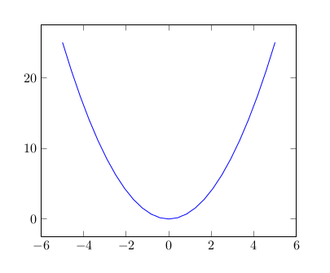

a) Learning rate is low b) Learning rate is high

